Slide 1


Slide 2
Async Best Practices for C# and VB
DEV-B362
Mads Torgersen

Slide 3
Key Takeaways
Async void is only for top-level event handlers.
Use the threadpool for CPU-bound code, but not IO-bound.
Use TaskCompletionSource to wrap Tasks around events.
Libraries shouldn't lie, and should be chunky.

Slide 4



Async void is only for event handlers
User:
“It mostly works, but not 100% reliably.”
Diagnosis & Fix:
Probably was using async void.
Should return Task not void.

Slide 5
Stop using async void!

Slide 6
Async void is only for event handlers
private async void Button1_Click(object Sender, EventArgs e) {
try {
SendData("https://secure.flickr.com/services/oauth/request_token");
await Task.Delay(2000);
DebugPrint("Received Data: " + m_GetResponse);
}
catch (Exception ex) {
rootPage.NotifyUser("Error posting data to server." + ex.Message);
}
}
private async void SendData(string Url) {
var request = WebRequest.Create(Url);
using (var response = await request.GetResponseAsync())
using (var stream = new StreamReader(response.GetResponseStream()))
m_GetResponse = stream.ReadToEnd();
}

Slide 7
Async void is only for event handlers
private async void Button1_Click(object Sender, EventArgs e) {
try {
SendData("https://secure.flickr.com/services/oauth/request_token");
// await Task.Delay(2000);
// DebugPrint("Received Data: " + m_GetResponse);
}
catch (Exception ex) {
rootPage.NotifyUser("Error posting data to server." + ex.Message);
}
}
private async void SendData(string Url) {
var request = WebRequest.Create(Url);
using (var response = await request.GetResponseAsync()) // exception on resumption
using (var stream = new StreamReader(response.GetResponseStream()))
m_GetResponse = stream.ReadToEnd();
}

Slide 8
Async void is only for event handlers
Principles
Async void is a “fire-and-forget” mechanism...
The caller is unable to know when an async void has finished
The caller is unable to catch exceptions thrown from an async void
(instead they get posted to the UI message-loop)
Guidance
Use async void methods only for top-level event handlers (and their like)
Use async Task-returning methods everywhere else
If you need fire-and-forget elsewhere, indicate it explicitly e.g. “FredAsync().FireAndForget()”
When you see an async lambda, verify it

Slide 9
Async void is only for event handlers
private async void Button1_Click(object Sender, EventArgs e) {
try {
SendData("https://secure.flickr.com/services/oauth/request_token");
await Task.Delay(2000);
DebugPrint("Received Data: " + m_GetResponse);
}
catch (Exception ex) {
rootPage.NotifyUser("Error posting data to server." + ex.Message);
}
}
private async void SendData(string Url) {
var request = WebRequest.Create(Url);
using (var response = await request.GetResponseAsync())
using (var stream = new StreamReader(response.GetResponseStream()))
m_GetResponse = stream.ReadToEnd();
}
Async
await
Task
Async

Slide 10
Async void is only for event handlers
// Q. It sometimes shows PixelWidth and PixelHeight are both 0 ???
BitmapImage m_bmp;
protected override async void OnNavigatedTo(NavigationEventArgs e) {
base.OnNavigatedTo(e);
await PlayIntroSoundAsync();
image1.Source = m_bmp;
Canvas.SetLeft(image1, Window.Current.Bounds.Width - m_bmp.PixelWidth);
}
protected override async void LoadState(Object nav, Dictionary<String, Object> pageState) {
m_bmp = new BitmapImage();
var file = await StorageFile.GetFileFromApplicationUriAsync("ms-appx:///pic.png");
using (var stream = await file.OpenReadAsync()) {
await m_bmp.SetSourceAsync(stream);
}
}
class LayoutAwarePage : Page
{
private string _pageKey;
protected override void OnNavigatedTo(NavigationEventArgs e)
{
if (this._pageKey != null) return;
this._pageKey = "Page-" + this.Frame.BackStackDepth;
...
this.LoadState(e.Parameter, null);
}
}

Slide 11
Async void is only for event handlers
// A. Use a task
Task<BitmapImage> m_bmpTask;
protected override async void OnNavigatedTo(NavigationEventArgs e) {
base.OnNavigatedTo(e);
await PlayIntroSoundAsync();
var bmp = await m_bmpTask; image1.Source = bmp;
Canvas.SetLeft(image1, Window.Current.Bounds.Width - bmp.PixelWidth);
}
protected override void LoadState(Object nav, Dictionary<String, Object> pageState) {
m_bmpTask = LoadBitmapAsync();
}
private async Task<BitmapImage> LoadBitmapAsync() {
var bmp = new BitmapImage();
...
return bmp;
}

Slide 12
Async void is only for event handlers
' In VB, the expression itself determines void- or Task-returning (not the context).
Dim void_returning = Async Sub()
Await LoadAsync() : m_Result = "done"
End Sub
Dim task_returning = Async Function()
Await LoadAsync() : m_Result = "done"
End Function
' If both overloads are offered, you must give it Task-returning.
Await Task.Run(Async Function() ... End Function)
// In C#, the context determines whether async lambda is void- or Task-returning.
Action a1 = async () => { await LoadAsync(); m_Result="done"; };
Func<Task> a2 = async () => { await LoadAsync(); m_Result="done"; };
// Q. Which one will it pick?
await Task.Run( async () => { await LoadAsync(); m_Result="done"; });
// A. If both overloads are offered, it will pick Task-returning. Good!
class Task
{
static public Task Run(Action a) {...}
static public Task Run(Func<Task> a) {...}
...
}

Slide 13
Async void is only for event handlers
try {
await Dispatcher.RunAsync(CoreDispatcherPriority.Normal, async () => {
await LoadAsync();
m_Result = "done";
throw new Exception();
});
}
catch (Exception ex) {
}
finally {
DebugPrint(m_Result);
}
// IAsyncAction RunAsync(CoreDispatcherPriority priority, DispatchedHandler agileCallback);
// delegate void DispatchedHandler();

Slide 14
Async void is only for event handlers
Principles
Async void is a “fire-and-forget” mechanism...
The caller is unable to know when an async void has finished
The caller is unable to catch exceptions thrown from an async void
(instead they get posted to the UI message-loop)
Guidance
Use async void methods only for top-level event handlers (and their like)
Use async Task-returning methods everywhere else
If you need fire-and-forget elsewhere, indicate it explicitly e.g. “FredAsync().FireAndForget()”
When you see an async lambda, verify it

Slide 15
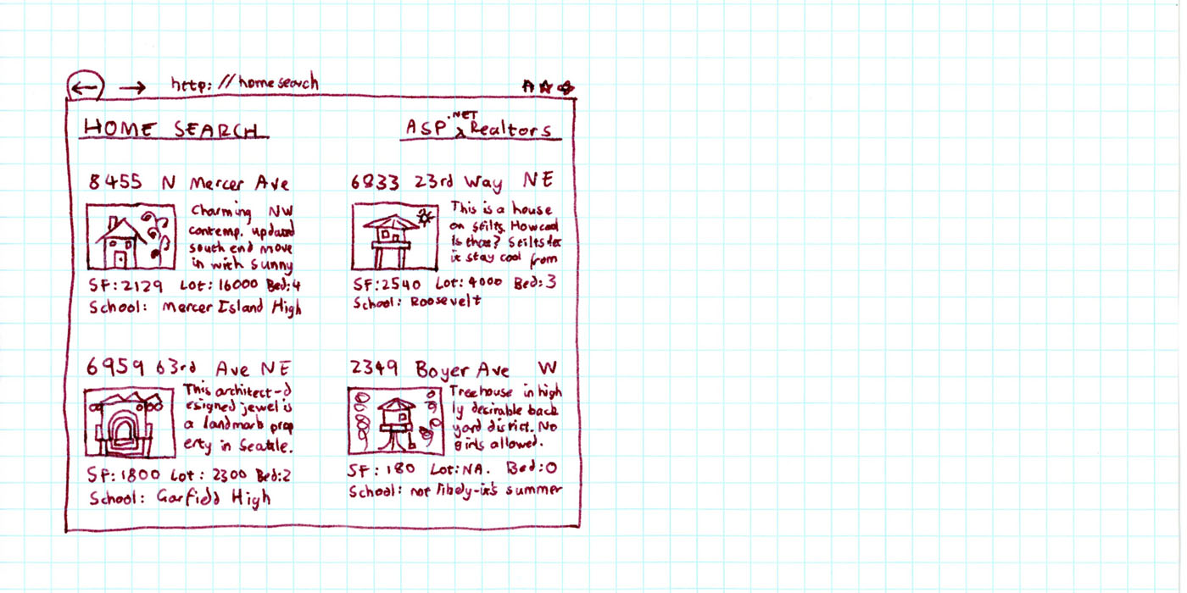

Threadpool
User:
“How to parallelize my code?”
Diagnosis & Fix:
User’s code was not CPU-bound:
should use await, not Parallel.For.

Slide 16
Threadpool
// table1.DataSource = LoadHousesSequentially(1,5);
// table1.DataBind();
public List<House> LoadHousesSequentially(int first, int last)
{
var loadedHouses = new List<House>();
for (int i = first; i <= last; i++) {
House house = House.Deserialize(i);
loadedHouses.Add(house);
}
return loadedHouses;
}
request in
work1
work2
work3
work4
work5
response out 500ms

Slide 17
Threadpool
// table1.DataSource = LoadHousesInParallel(1,5);
// table1.DataBind();
public List<House> LoadHousesInParallel(int first, int last)
{
var loadedHouses = new BlockingCollection<House>();
Parallel.For(first, last+1, i => {
House house = House.Deserialize(i);
loadedHouses.Add(house);
});
return loadedHouses.ToList();
}
request in
Parallel.For
work1
work2
1
2
work3
work4
4
5
3
work5
response out 300ms

Slide 18
Is it CPU-bound, or I/O-bound?

Slide 19
Threadpool
request in
start1
end1
start2
end2
start3
end3
start4
end4
start5
response out 500ms
end5

Slide 20
Threadpool
request in
Parallel.For
start1
start2
start3
end1
end2
start4
2
1
start2
start1
end3
end2
start5
end4
end1
4
start4
end4
end5
3
start5
start3
5
end5
end3
response out ~200ms

Slide 21
Threadpool
request in
start1
start2
start3
start4
start5
end2
end5
end1
end3
end4
response out ~100ms

Slide 22
Threadpool
// table1.DataSource = await LoadHousesAsync(1,5);
// table1.DataBind();
public async Task<List<House>> LoadHousesAsync(int first, int last)
{
var tasks = new List<Task<House>>();
for (int i = first; i <= last; i++)
{
Task<House> t = House.LoadFromDatabaseAsync(i);
tasks.Add(t);
}
House[] loadedHouses = await Task.WhenAll(tasks);
return loadedHouses.ToList();
}

Slide 23
Threadpool
public async Task<List<House>> LoadHousesAsync(int first, int last)
{
var loadedHouses = new List<House>();
var queue = new Queue<int>(Enumerable.Range(first, last – first + 1));
// Throttle the rate of issuing requests...
var worker1 = WorkerAsync(queue, loadedHouses);
var worker2 = WorkerAsync(queue, loadedHouses);
var worker3 = WorkerAsync(queue, loadedHouses);
await Task.WhenAll(worker1, worker2, worker3);
return loadedHouses;
}
private async Task WorkerAsync(Queue<int> queue, List<House> results)
{
while (queue.Count > 0)
{
int i = queue.Dequeue();
var house = await House.LoadFromDatabaseAsync(i);
results.Add(house);
}
}

Slide 24
Threadpool
Principles
CPU-bound work means things like: LINQ-over-objects, or big iterations, or computational inner loops.
Parallel.ForEach and Task.Run are a good way to put CPU-bound work onto the thread pool.
Thread pool will gradually feel out how many threads are needed to make best progress.
Use of threads will never increase throughput on a machine that’s under load.
Guidance
For IO-bound “work”, use await rather than background threads.
For CPU-bound work, consider using background threads via Parallel.ForEach or Task.Run, unless you're writing a library, or scalable server-side code.

Slide 25

Async over events
User:
“My UI code looks like spaghetti.”
Diagnosis & Fix:
Events are the problem.
Consider wrapping them as Tasks.

Slide 26

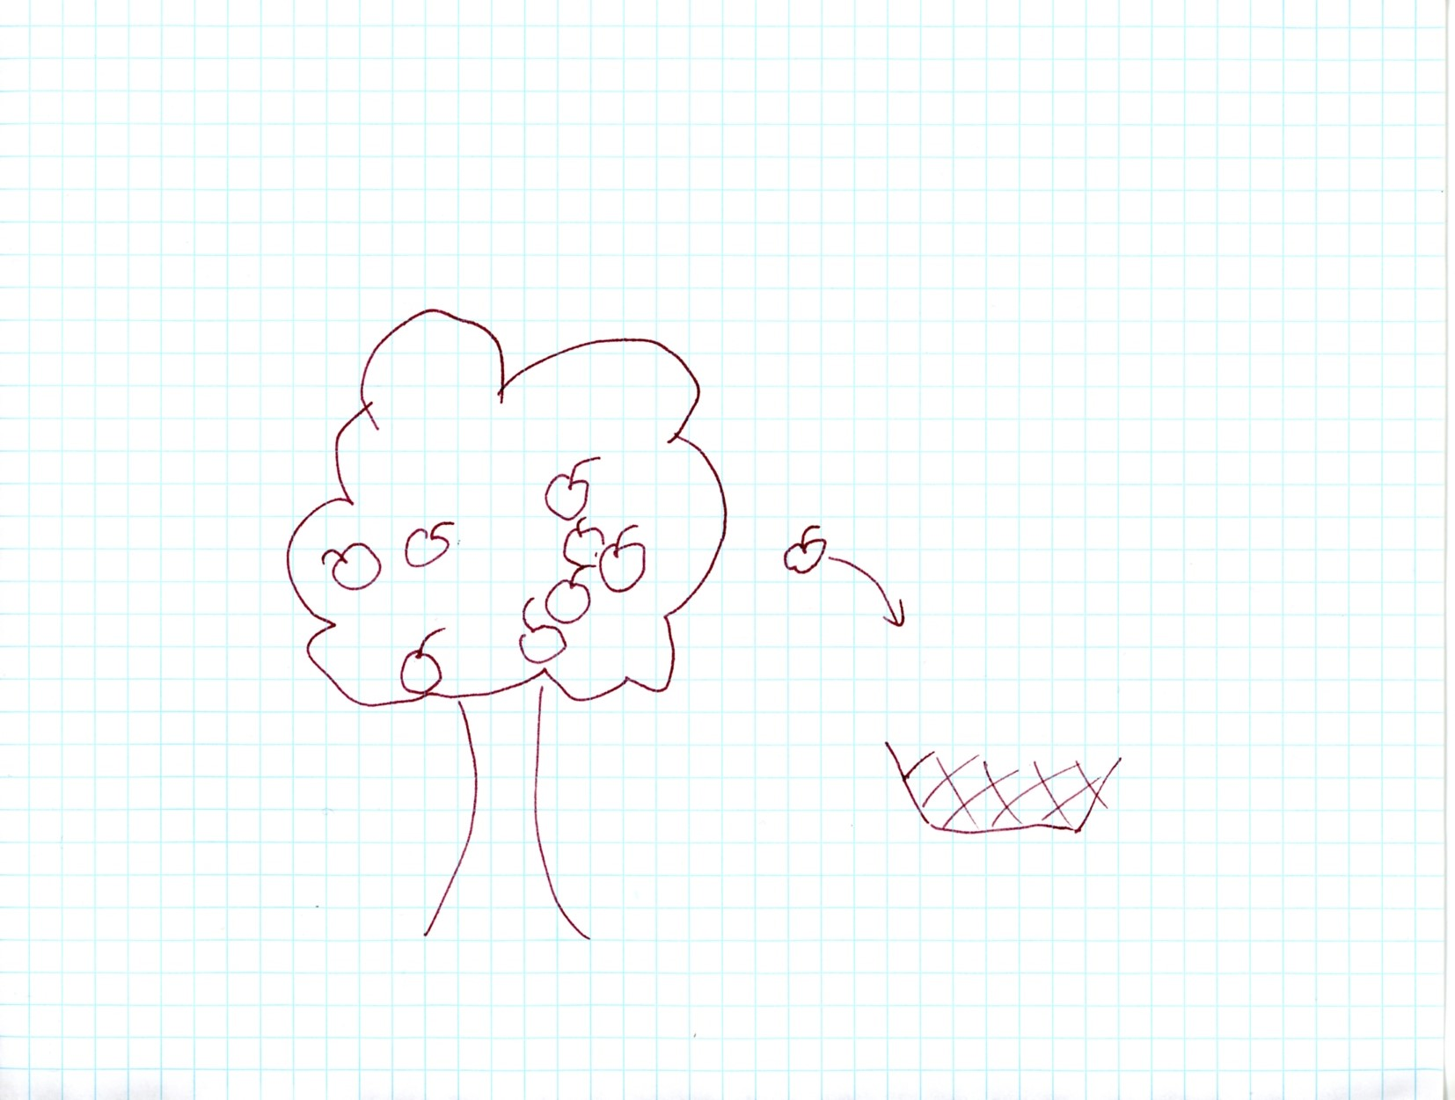

Async over events

Slide 27
Async over events
Protected Overrides Sub OnPointerPressed(e As PointerRoutedEventArgs)
Dim apple = CType(e.OriginalSource, Image)
AddHandler apple.PointerReleased,
Sub(s, e2)
Dim endpt = e2.GetCurrentPoint(Nothing).Position
If Not BasketCatchmentArea.Bounds.Contains(endpt) Then Return
Canvas.SetZIndex(apple, 1) ' mark apple as no longer free
If FreeApples.Count > 0 Then
m_ActionAfterAnimation = Sub()
WhooshSound.Stop()
ShowVictoryWindow()
AddHandler btnOk.Click, Sub()
....
End Sub
End Sub
End If
WhooshSound.Play()
AnimateThenDoAction(AppleIntoBasketStoryboard)

Slide 28


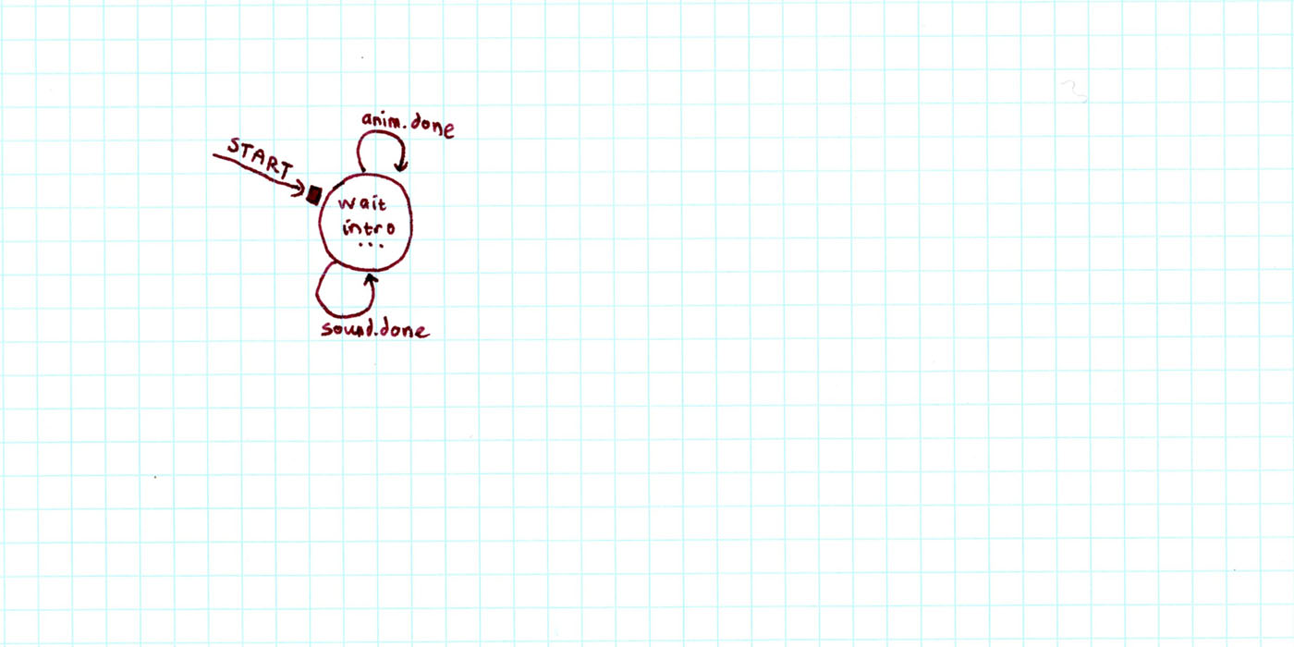
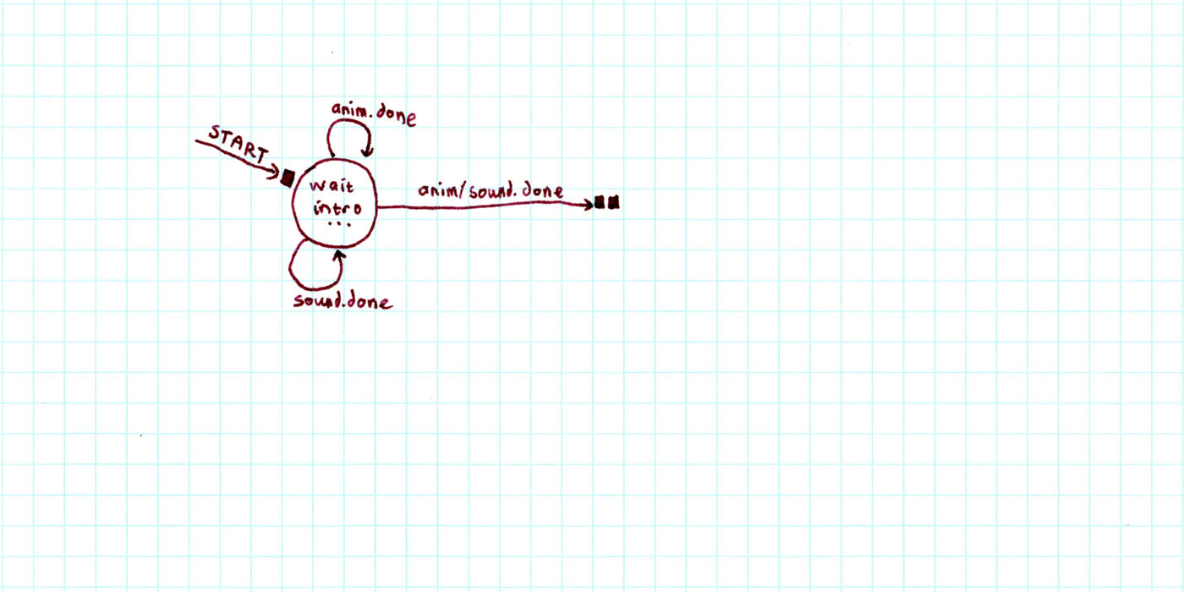
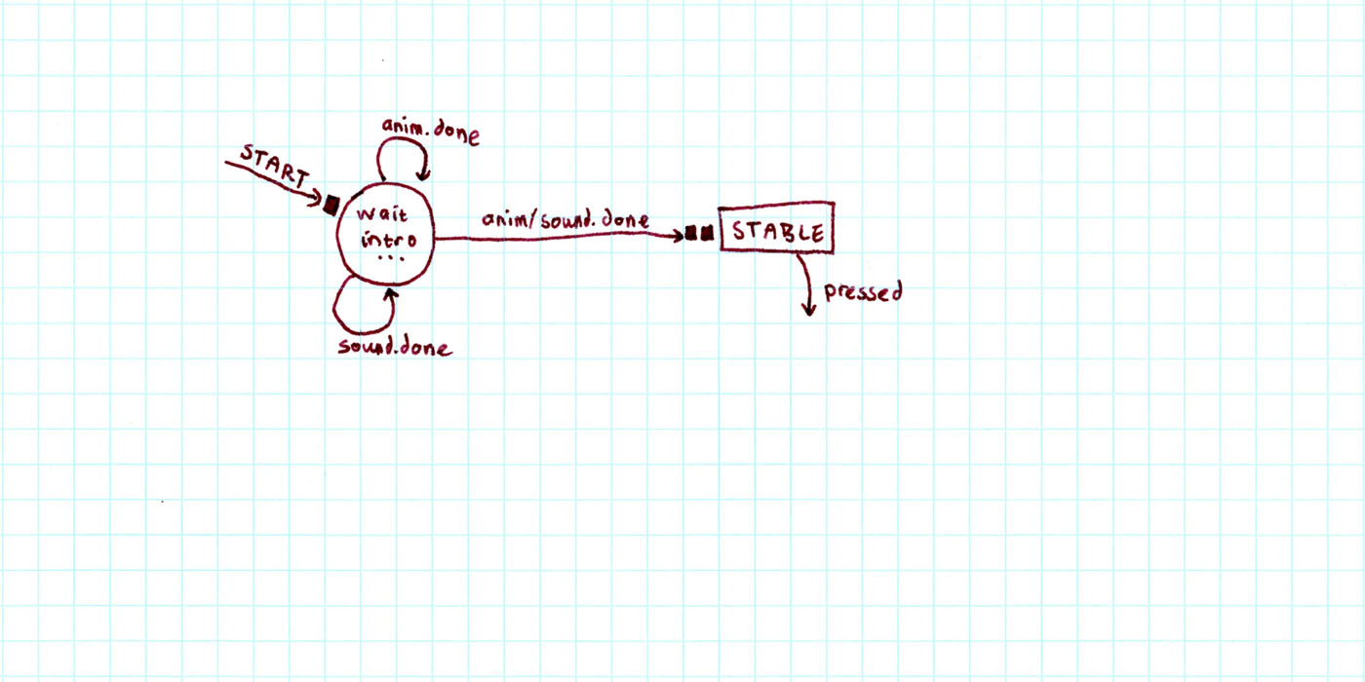
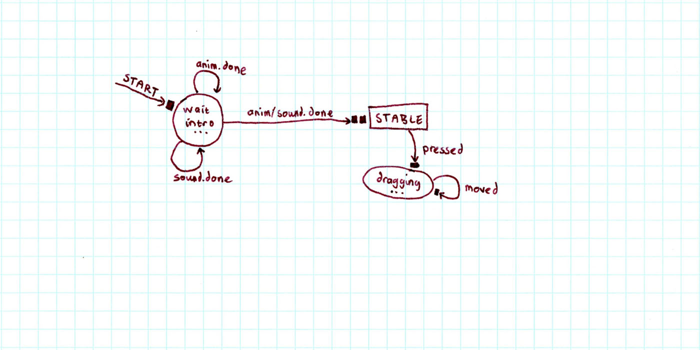
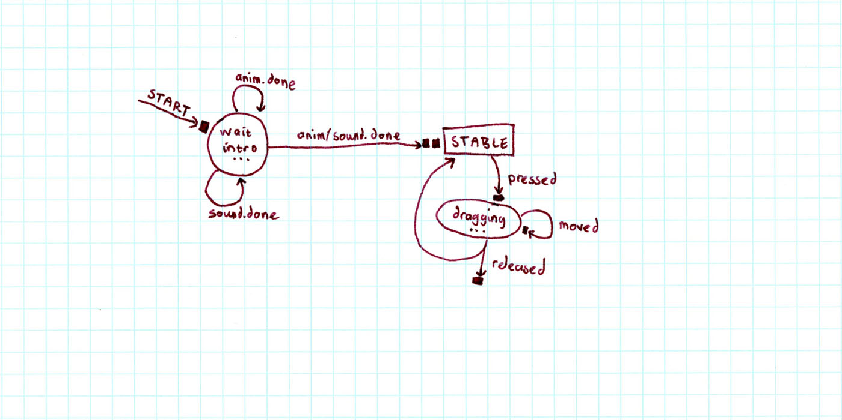
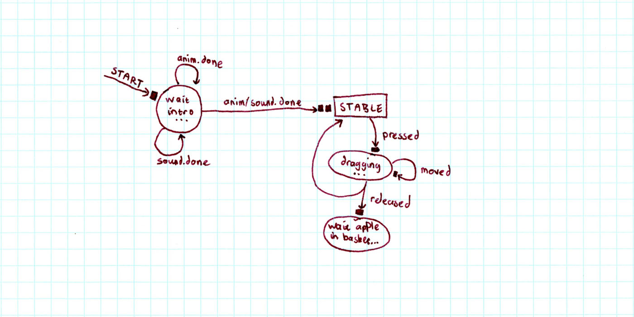
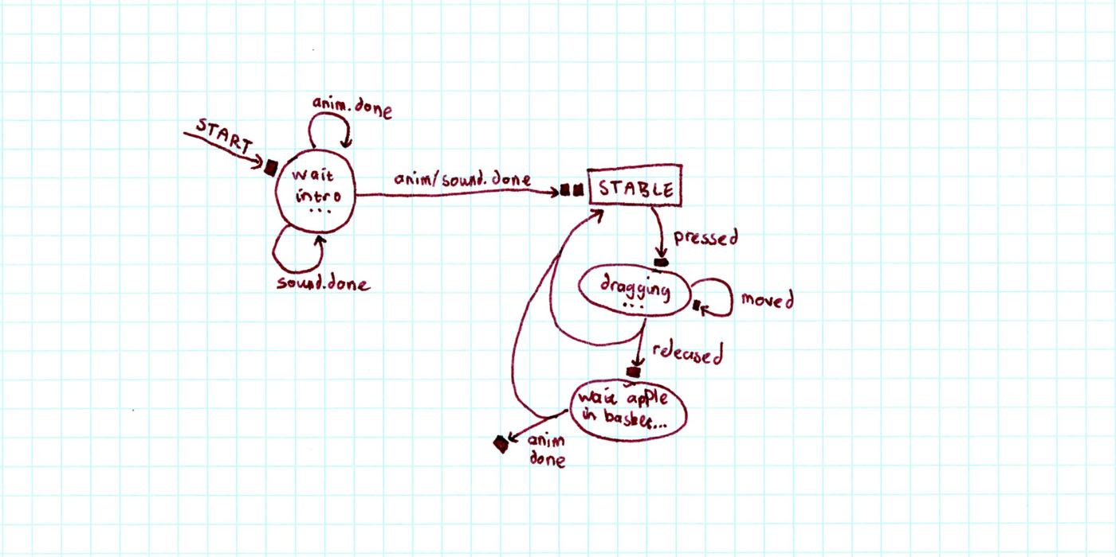
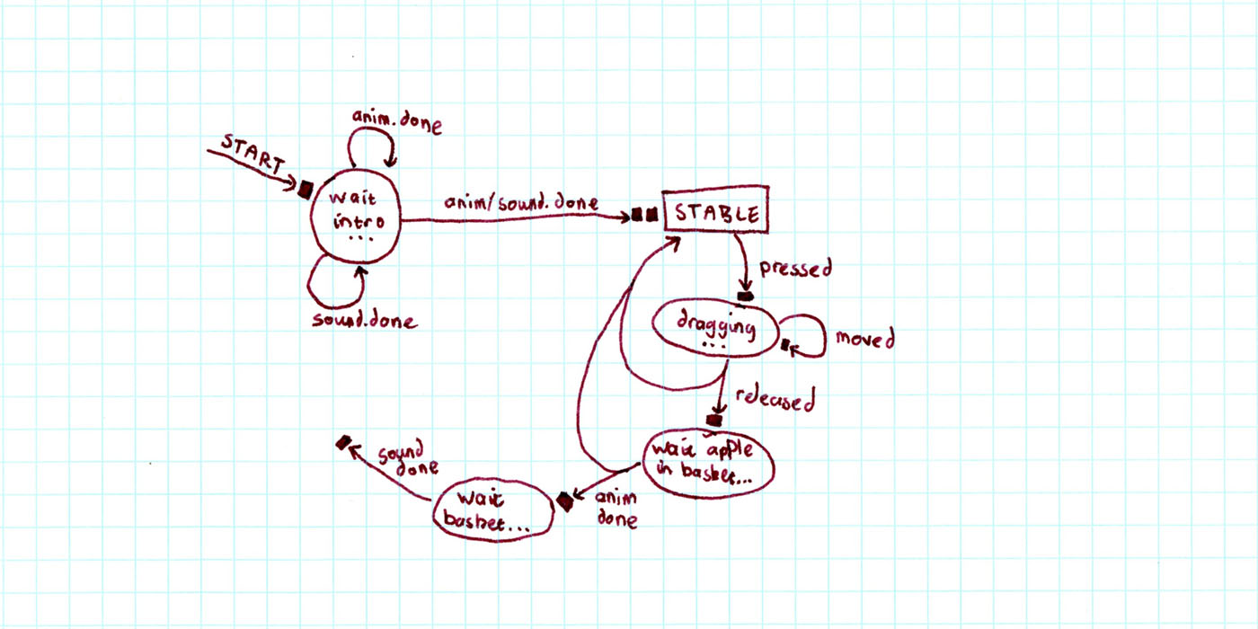
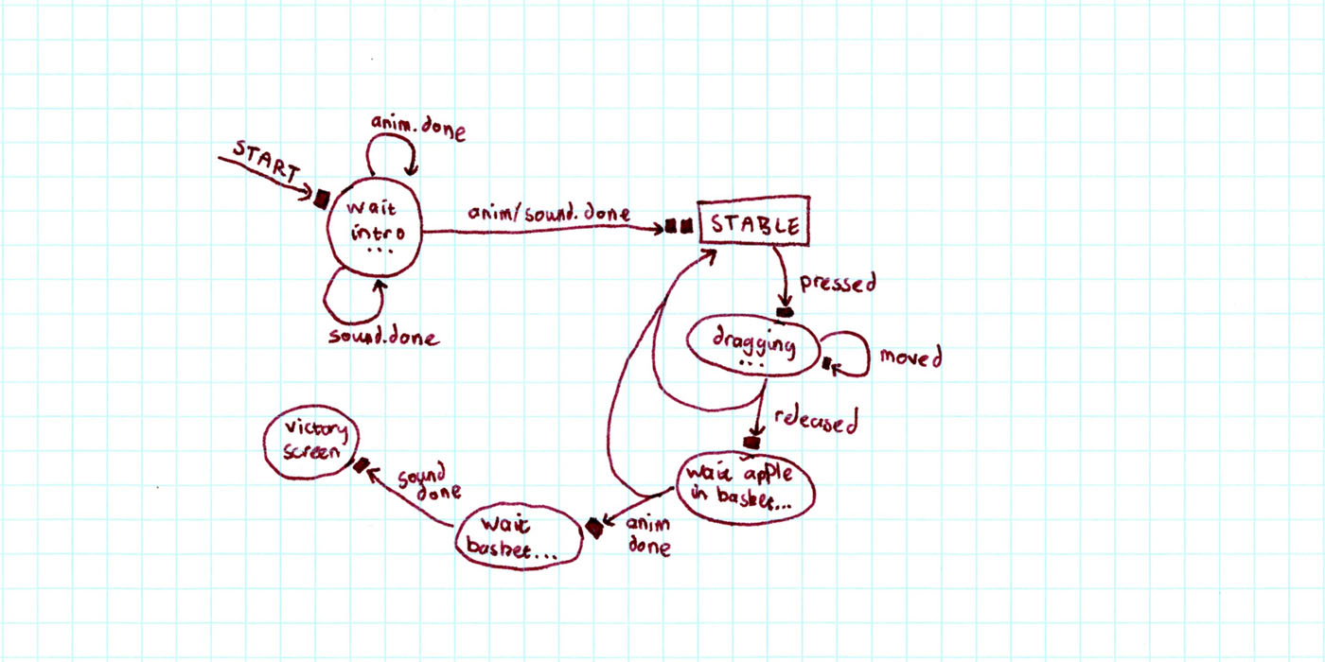
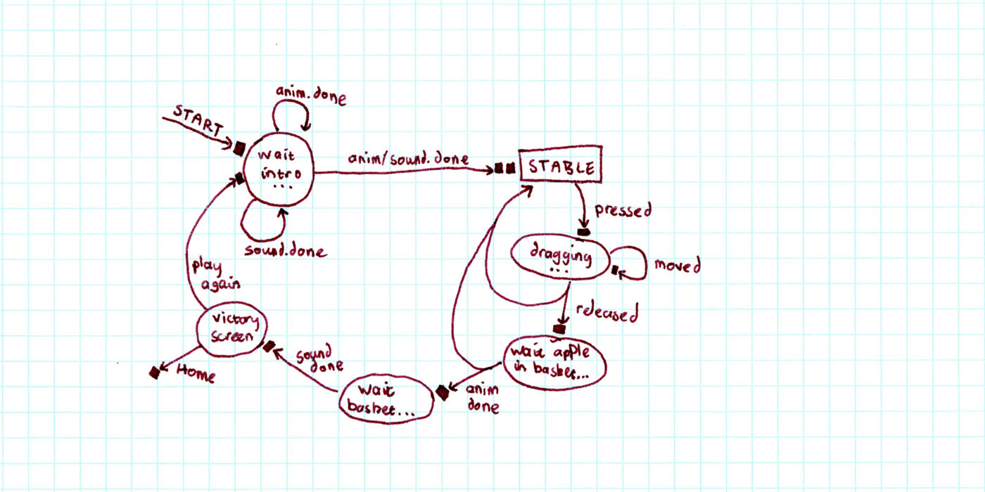
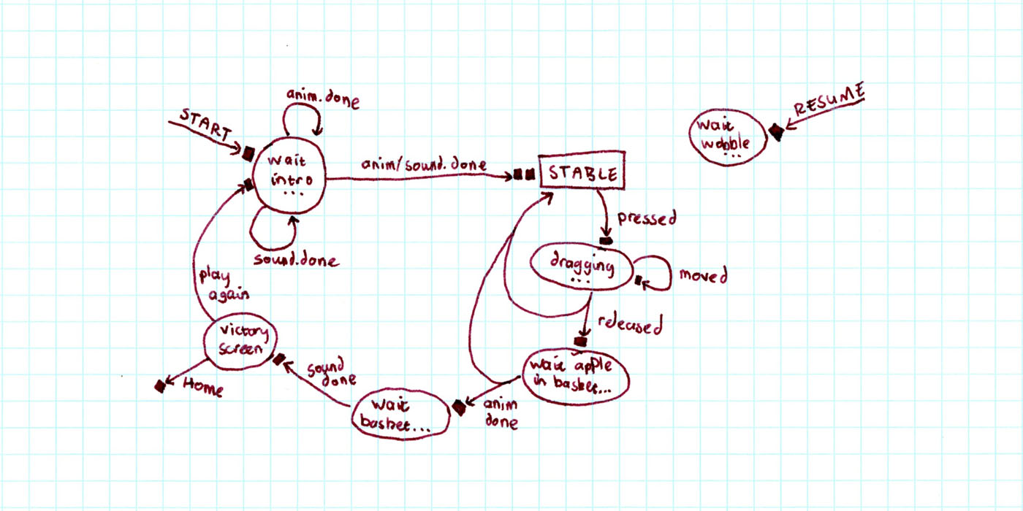
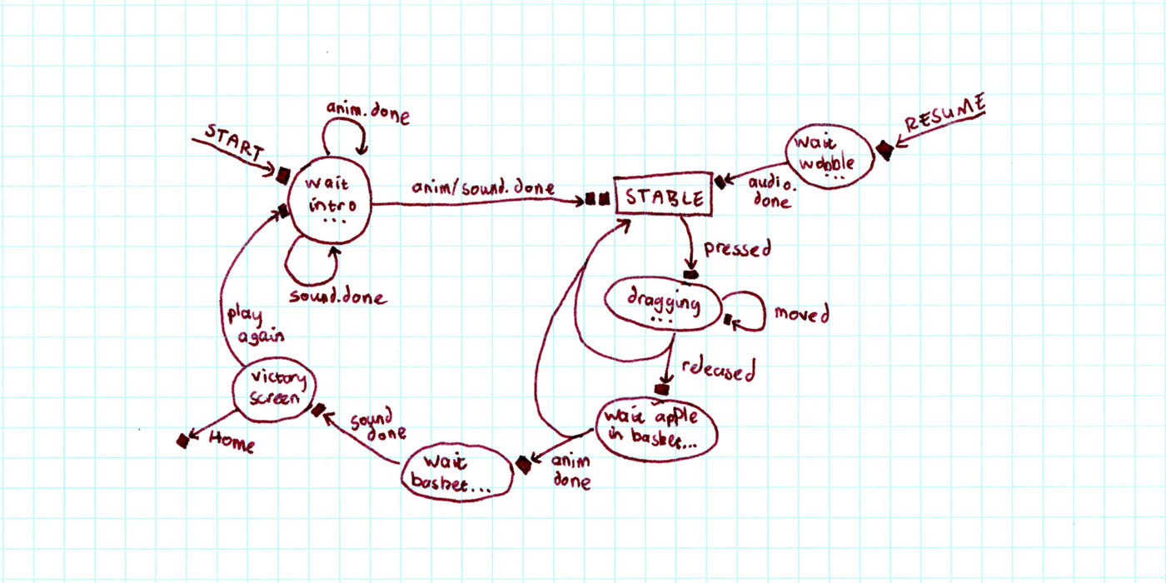
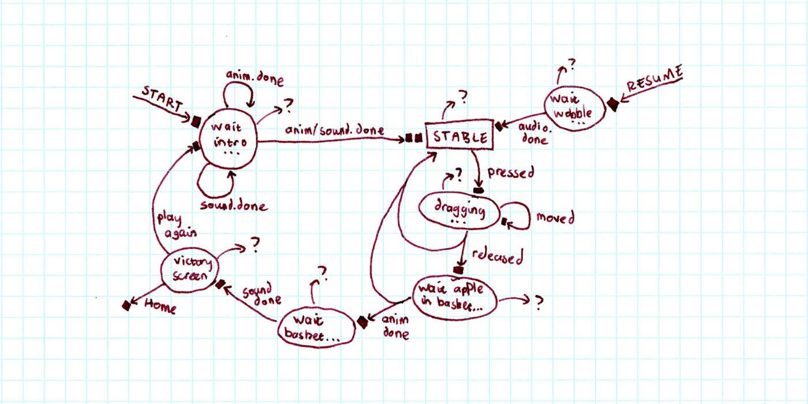
Async over events

Slide 29
The problem is events. They’re not going away.

Slide 30
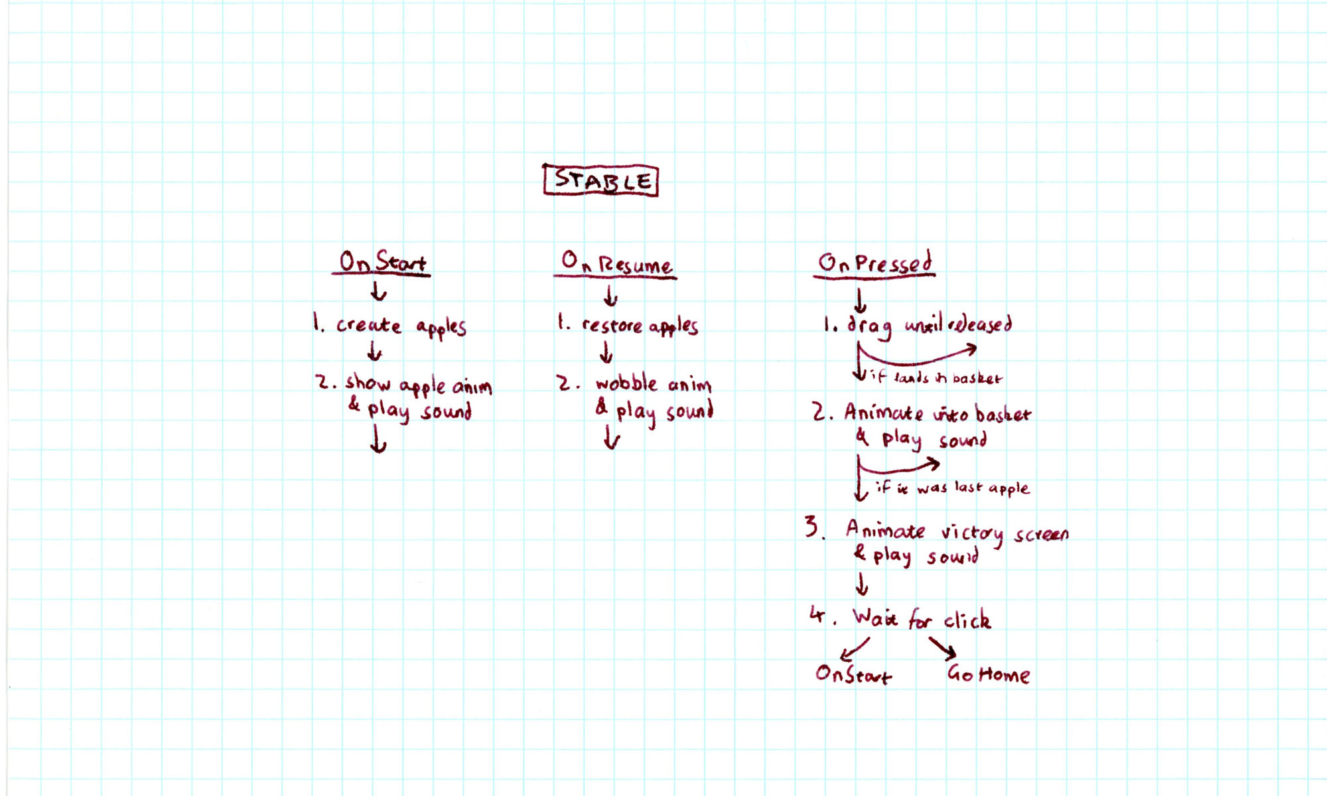
Async over events

Slide 31
Async over events
Protected Async Sub OnPointerPressed(e As PointerRoutedEventArgs)
' Let user drag the apple
Dim apple = CType(e.OriginalSource, Image)
Dim endpt = Await DragAsync(apple)
If Not BasketCatchmentArea.Bounds.Contains(endpt) Then Return
' Animate and sound for apple to whoosh into basket
Dim animateTask = AppleStoryboard.PlayAsync()
Dim soundTask = WhooshSound.PlayAsync()
Await Task.WhenAll(animateTask, soundTask)
If FreeApples.Count = 0 Then Return
' Show victory screen, and wait for user to click button
Await StartVictoryScreenAsync()
Await btnPlayAgain.WhenClicked()
OnStart()
End Sub

Slide 32
Async over events
' Usage: Await storyboard1.PlayAsync()
<Extension> Async Function PlayAsync(sb As Animation.Storyboard) As Task
Dim tcs As New TaskCompletionSource(Of Object)
Dim lambda As EventHandler(Of Object) = Sub() tcs.TrySetResult(Nothing)
Try
AddHandler sb.Completed, lambda
sb.Begin()
Await tcs.Task
Finally
RemoveHandler sb.Completed, lambda
End Try
End Function
// Usage: await storyboard1.PlayAsync();
public static async Task PlayAsync(this Storyboard storyboard)
{
var tcs = new TaskCompletionSource<object>();
EventHandler<object> lambda = (s,e) => tcs.TrySetResult(null);
try {
storyboard.Completed += lambda;
storyboard.Begin();
await tcs.Task;
}
finally {
storyboard.Completed -= lambda;
}
}

Slide 33
Async over events
// Usage: await button1.WhenClicked();
public static async Task WhenClicked(this Button button)
{
var tcs = new TaskCompletionSource<object>();
RoutedEventHandler lambda = (s,e) => tcs.TrySetResult(null);
try {
button.Click += lambda;
await tcs.Task;
}
finally {
button.Click -= lambda;
}
}

Slide 34
Async over events
Principles
Callback-based programming, as with events, is hard
Guidance
If the event-handlers are largely independent, then leave them as events
But if they look like a state-machine, then await is sometimes easier
To turn events into awaitable Tasks, use TaskCompletionSource

Slide 35

Library methods shouldn’t lie
Library methods shouldn’t lie…
Only expose an async API if your implementation is truly async.
Don’t “fake it” through internal use of Task.Run.

Slide 36
Library methods shouldn’t lie
Foo();
This method’s signature is synchronous:
I expect it will perform something here and now. I’ll regain control to execute something else when it’s done.
It will probably be using the CPU flat-out while it runs.
var task = FooAsync();
...
await task;
This method’s signature is asynchronous:
I expect it will initiate something here and now. I’ll regain control to execute something else immediately.
It probably won’t take significant threadpool or CPU resources. ***
I could even kick off two FooAsyncs() to run them in parallel.

Slide 37
Library methods shouldn’t lie
“Pause for 10 seconds, then print 'Hello'.”
Synchronous
Asynchronous
public static void PausePrint() { var end = DateTime.Now + TimeSpan.FromSeconds(10); while (DateTime.Now < end) { } Console.WriteLine("Hello"); }
public static Task PausePrint2Async() { return Task.Run(() => PausePrint()); }
// “I want to offer an async signature, // but my underlying library is synchronous”
USING A THREAD.
Looks async, but isn’t
“Should I expose async wrappers for synchronous methods?” – generally no!
http://blogs.msdn.com/b/pfxteam/archive/2012/03/24/10287244.aspx
public static Task PausePrintAsync() { var tcs = new TaskCompletionSource<bool>(); new Timer(_ => { Console.WriteLine("Hello"); tcs.SetResult(true); }).Change(10000, Timeout.Infinite); return tcs.Task; }
public static void PausePrint2() { Task t = PausePrintAsync(); t.Wait(); }
// “I’m not allowed an async signature, // but my underlying library is async”
public static async Task PausePrintAsync() { await Task.Delay(10000); Console.WriteLine("Hello"); }
BLOCKING.
Looks sync, but isn’t
TRUE ASYNC.
“How can I expose sync wrappers for async methods?” – if you absolutely have to, you can use a nested message-loop…
http://blogs.msdn.com/b/pfxteam/archive/2012/04/13/10293638.aspx

Slide 38
The dangers of
LIBRARIES THAT USE TASK.RUN
(looks async, but it wraps a sync implementation)
The threadpool is an app-global resource
The number of threads available to service work items varies greatly over the life of an app
The thread pool adds and removes threads using a hill climbing algorithm that adjusts slowly
In a server app, spinning up threads hurts scalability
A high-traffic server app may choose to optimize for scalability over latency
An API that launches new threads unexpectedly can cause hard-to-diagnose scalability bottlenecks
The app is in the best position to manage its threads
Provide synchronous methods when you do CPU-work that blocks the current thread
Provide asynchronous methods when you can do so without spawning new threads
Let the app that called you use its domain knowledge to manage its threading strategy (e.g. Task.Run)

Slide 39
The dangers of
BLOCKING
(looks sync, but it wraps an async/await method)
Click
Task ... LoadAsync
void Button1_Click(){ var t = LoadAsync();
t.Wait();
UpdateView(); }
async Task LoadAsync() {
await IO.Network.DownloadAsync(path); }
Message pump
Task ... DownloadAsync
Download

Slide 40
Library methods shouldn’t lie
Principles
The threadpool is an app-global resource.
Poor use of the threadpool hurts server scalability.
Guidance
Help your callers understand how your method behaves:
Libraries shouldn’t use the threadpool in secret;
Use async signature only for truly async methods.

Slide 41
Libraries should expose chunky async APIs
Async perf overhead is fine, unless you have a chatty API.
Don't await 10 million times in an inner loop.
But if you have to, then optimize using fast-path and caching.

Slide 42
Libraries should expose chunky async APIs
We all know sync methods are “cheap”
Years of optimizations around sync methods
Enables refactoring at will
public static void SimpleBody() {
Console.WriteLine("Hello, Async World!");
}
.method public hidebysig static void SimpleBody() cil managed
{
.maxstack 8
L_0000: ldstr "Hello, Async World!"
L_0005: call void [mscorlib]System.Console::WriteLine(string)
L_000a: ret
}

Slide 43
Libraries should expose chunky async APIs
.method public hidebysig instance void MoveNext() cil managed
{
// Code size 66 (0x42)
.maxstack 2
.locals init ([0] bool '<>t__doFinallyBodies', [1] class [mscorlib]System.Exception '<>t__ex')
.try
{
IL_0000: ldc.i4.1
IL_0001: stloc.0
IL_0002: ldarg.0
IL_0003: ldfld int32 Program/'<SimpleBody>d__0'::'<>1__state'
IL_0008: ldc.i4.m1
IL_0009: bne.un.s IL_000d
IL_000b: leave.s IL_0041
IL_000d: ldstr "Hello, Async World!"
IL_0012: call void [mscorlib]System.Console::WriteLine(string)
IL_0017: leave.s IL_002f
}
catch [mscorlib]System.Exception
{
IL_0019: stloc.1
IL_001a: ldarg.0
IL_001b: ldc.i4.m1
IL_001c: stfld int32 Program/'<SimpleBody>d__0'::'<>1__state'
IL_0021: ldarg.0
IL_0022: ldflda valuetype [mscorlib]System.Runtime.CompilerServices.AsyncTaskMethodBuilder
Program/'<SimpleBody>d__0'::'<>t__builder'
IL_0027: ldloc.1
IL_0028: call instance void [mscorlib]System.Runtime.CompilerServices.AsyncTaskMethodBuilder::SetException(
class [mscorlib]System.Exception)
IL_002d: leave.s IL_0041
}
IL_002f: ldarg.0
IL_0030: ldc.i4.m1
IL_0031: stfld int32 Program/'<SimpleBody>d__0'::'<>1__state'
IL_0036: ldarg.0
IL_0037: ldflda valuetype [mscorlib]System.Runtime.CompilerServices.AsyncTaskMethodBuilder
Program/'<SimpleBody>d__0'::'<>t__builder'
IL_003c: call instance void [mscorlib]System.Runtime.CompilerServices.AsyncTaskMethodBuilder::SetResult()
IL_0041: ret
}
Not so for asynchronous methods
public static async Task SimpleBody() {
Console.WriteLine("Hello, Async World!");
}
.method public hidebysig static class [mscorlib]System.Threading.Tasks.Task SimpleBody() cil managed
{
.custom instance void [mscorlib]System.Diagnostics.DebuggerStepThroughAttribute::.ctor() = ( 01 00 00 00 )
// Code size 32 (0x20)
.maxstack 2
.locals init ([0] valuetype Program/'<SimpleBody>d__0' V_0)
IL_0000: ldloca.s V_0
IL_0002: call valuetype [mscorlib]System.Runtime.CompilerServices.AsyncTaskMethodBuilder
[mscorlib]System.Runtime.CompilerServices.AsyncTaskMethodBuilder::Create()
IL_0007: stfld valuetype [mscorlib]System.Runtime.CompilerServices.AsyncTaskMethodBuilder Program/'<SimpleBody>d__0'::'<>t__builder'
IL_000c: ldloca.s V_0
IL_000e: call instance void Program/'<SimpleBody>d__0'::MoveNext()
IL_0013: ldloca.s V_0
IL_0015: ldflda valuetype [mscorlib]System.Runtime.CompilerServices.AsyncTaskMethodBuilder Program/'<SimpleBody>d__0'::'<>t__builder'
IL_001a: call instance class [mscorlib]System.Threading.Tasks.Task [mscorlib]System.Runtime.CompilerServices.AsyncTaskMethodBuilder::get_Task()
IL_001f: ret
}
The important mental model:
* Allocation will eventually require garbage-collection
* Garbage-collection is what's costly.

Slide 44
Fast Path in awaits
Avoided if the method skips its awaits
Each async method involves allocations…
For “state machine” class holding the method’s local variables
For a delegate
For the returned Task object
public static async Task<int> GetNextIntAsync()
{
if (m_Count == m_Buf.Length)
{
m_Buf = await FetchNextBufferAsync();
m_Count = 0;
}
m_Count += 1;
return m_Buf[m_Count - 1];
}

Slide 45
Fast Path in awaits
If the awaited Task has already completed…
then it skips all the await/resume work!
var x = await GetNextIntAsync();
var $awaiter = GetNextIntAsync().GetAwaiter();
if (!$awaiter.IsCompleted) {
DO THE AWAIT/RETURN AND RESUME;
}
var x = $awaiter.GetResult();

Slide 46
Fast Path in awaits
Avoided if the method skips its awaits
Each async method involves allocations…
For “state machine” class holding the method’s local variables
For a delegate
For the returned Task object
Avoided if the method took fast path, AND the returned value was “common” …
0, 1, true, false, null, “”
public static async Task<int> GetNextIntAsync()
{
if (m_Count == m_Buf.Length)
{
m_Buf = await FetchNextBufferAsync();
m_Count = 0;
}
m_Count += 1;
return m_Buf[m_Count - 1];
}
For other returns values, try caching yourself!

Slide 47
Libraries should expose chunky async APIs
Principles
The heap is an app-global resource.
Like all heap allocations, async allocations can contributing to hurting GC perf.
Guidance
Libraries should expose chunky async APIs, not chatty.
If your library has to be chatty, and GC perf is a problem, and the heap has lots of async allocations, then optimize the fast-path.

Slide 48
Consider .ConfigureAwait(false) in libraries
Library methods might be called from different contexts:
Consider .ConfigureAwait(false).

Slide 49
Consider .ConfigureAwait(false) in libraries
Sync context represents a “target for work”
e.g. WindowsFormsSynchronizationContext, whose .Post() does Control.BeginInvoke
e.g. DispatcherSynchronizationContext, whose .Post() does Dispatcher.BeginInvoke
e.g. AspNetSynchronizationContext, whose .Post() ensures one-at-a-time
“Await task” uses the sync context
1. It captures the current SyncContext before awaiting.
2. Upon task completion, it calls SyncContext.Post() to resume “where you were before”
For app-level code, this is fine. But for library code, it’s rarely needed!
You can use “await task.ConfigureAwait(false)”
This suppresses step 2; instead if possible it resumes “on the thread that completed the task”
Result: slightly better performance. Also can avoid deadlock if a badly-written user blocks.

Slide 50
Consider .ConfigureAwait(false) in libraries
Principles
The UI message-queue is an app-global resource.
Too much use will hurt UI responsiveness.
Guidance
If your method calls chatty async APIs, but doesn’t touch the UI, then use ConfigureAwait(false)

Slide 51

Related talks
Mon 1:15pm: The Present and Future of .NET
Mon 4:15pm: The Next Generation of .NET
Tue 1:30pm: The Future of C# and VB
Tue 3:15pm: VS Power User: Tips and Tricks
Thu 10:15am: Async Best Practices for C# and VB
Find me:
Thu 1:30pm-3:00pm: MSE booths

Slide 52
Resources for async best practices
Stephen Toub’s blog: http://blogs.msdn.com/b/pfxteam
Lucian Wischik’s blog: http://blogs.msdn.com/b/lucian
Stephen Cleary’s blog: http://blog.stephencleary.com
MSDN: http://msdn.microsoft.com/async

Slide 53
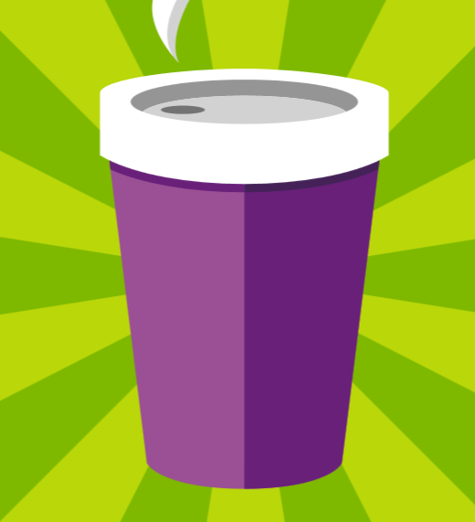








Visit the Developer Platform & Tools Booth
Having a friend buy your coffee?
Yea, it’s kind of like that.
MSDN Subscribers get up to $150/mo in Azure credits.
Stop by the Developer Platform and Tools booth and visit the MSDN Subscriptions station to activate your benefits and receive a gift!
http://aka.ms/msdn_teched
3 Steps to New Gear! With Application Insights
Create a Visual Studio Online account http://visualstudio.com
Install Application Insights Tools for Visual Studio Online http://aka.ms/aivsix
Come to our booth for a t-shirt and a chance to win!
VSIP QR Tag Contests
Visit our booth to join the hunt for cool prizes!

Slide 54


Resources
Microsoft Engineering Stories
Development tools & services for teams of all sizes
How Microsoft Builds Software
http://aka.ms/EngineeringStories
http://www.visualstudio.com
Visual Studio Industry Partner Program
Visual Studio | Integrate
Meet Our New Visual Studio Online Partners or Join Now.
http://vsipprogram.com
Create Your Own Dev Environment
http://integrate.visualstudio.com

Slide 55
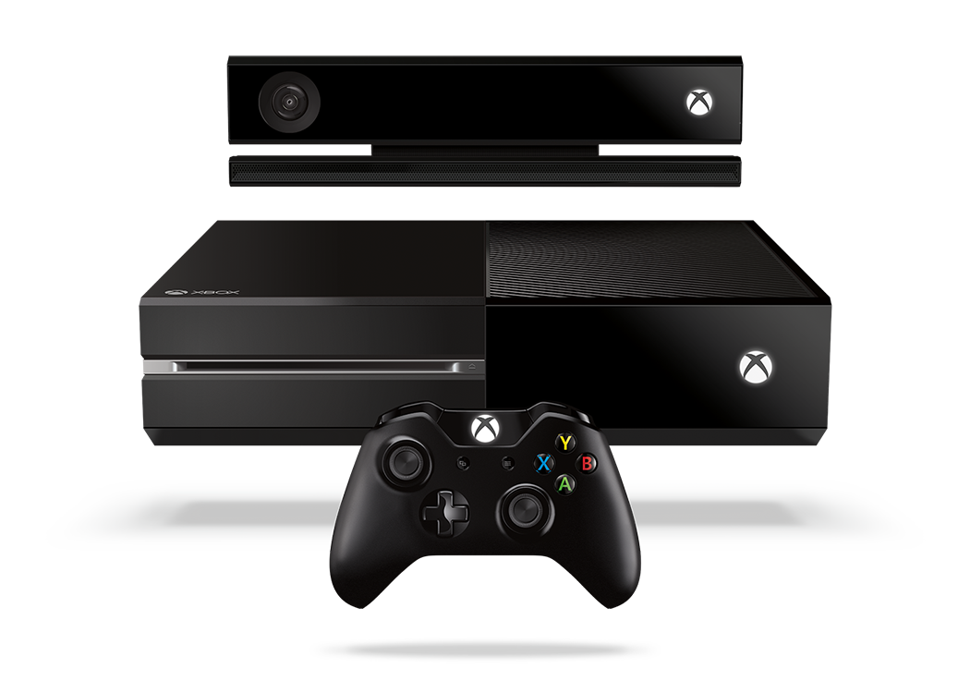


Complete an evaluation and enter to win!

Slide 56

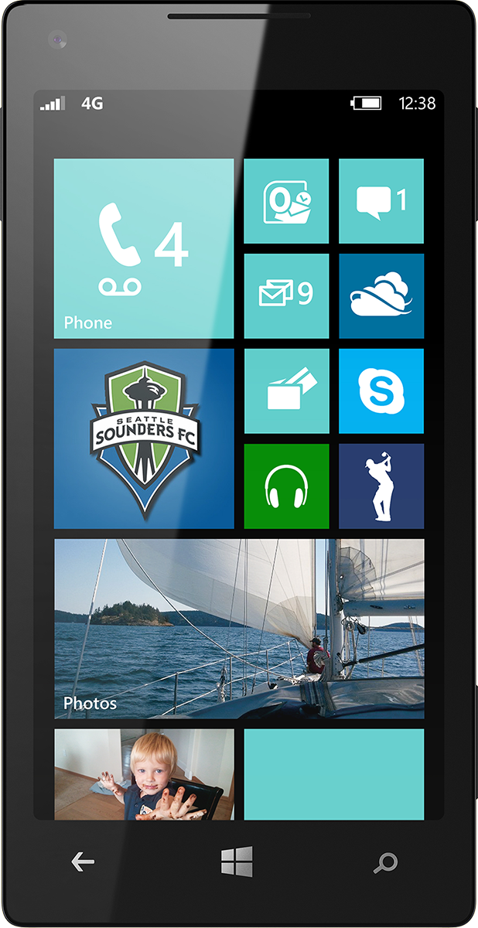
Evaluate this session
Scan this QR code to evaluate this session.

Slide 57


© 2014 Microsoft Corporation. All rights reserved. Microsoft, Windows, and other product names are or may be registered trademarks and/or trademarks in the U.S. and/or other countries.
The information herein is for informational purposes only and represents the current view of Microsoft Corporation as of the date of this presentation. Because Microsoft must respond to changing market conditions, it should not be interpreted to be a commitment on the part of Microsoft, and Microsoft cannot guarantee the accuracy of any information provided after the date of this presentation. MICROSOFT MAKES NO WARRANTIES, EXPRESS, IMPLIED OR STATUTORY, AS TO THE INFORMATION IN THIS PRESENTATION.

